Slide 1
Design Patterns and Clean Coding

Slide 2
Topics
Need of Design Patterns
GOF Patterns
Creational Pattern
Behavioural Pattern
Structural Pattern

Slide 3
Need of Design Patterns
Christopher Alexander (Architect) says that “A design pattern is something which is re-usable, maintainable or upgradable form a solution to design an application”.
Ask yourself… Everyone here has smartphones, laptops etc who develops them? Who provides services to them? Are they same? For eg say you are using a mobile developed by Abc Mobiles will you go to the developer for the service or to the service center?
You have bikes, cars, Tv’s and many more things which are developed by someone and is being serviced by someone. How they are able to do so? Design patterns is answer to all of this.
Same analogy goes to software developer as well who develops applications or improvises the application or service an application which is developed by other developer.

Slide 4
Need of Design Patterns
So as a Developer applying patterns which are industries best practices helps anyone to understand the way we have written the code and can improvise or update or debug and do many more things.
Bad design leads to bad application which lacks quality and upgrades.
“How about you guys give me an example of a bad and a good design in your day-to-day life” ☺
So how you guys facing difficulty in your day-to-day life due to bad design similar issues we face when we develop apps, imagine all Classes of java in same package, imagine bad method names and variable names and lots of repetition of lines of code across.
“How about you guys say some bad designs in the code now”? ☺ and also best way according to you should be the best design.

Slide 5
Need of Design Patterns
So design patterns are like templates or blueprints to develop any application, lots of industry experts have suggested the ways based on their experience to write the better reusable code by applying design patterns. Again an example of an architect(civil engineer) who builds your building by showing all the possible blueprints(pattern) where after few years if you wish to customize your building, you can easily.
Do remember that the pattern doesn’t mean its lines of codes its an ideology to solve a particular problem in a particular style.
We often get confused with Pattern and Algorithm are same, but they are not same.
Understanding the pattern , the way to be developed a better application is important for the quality of the code as well.

Slide 6
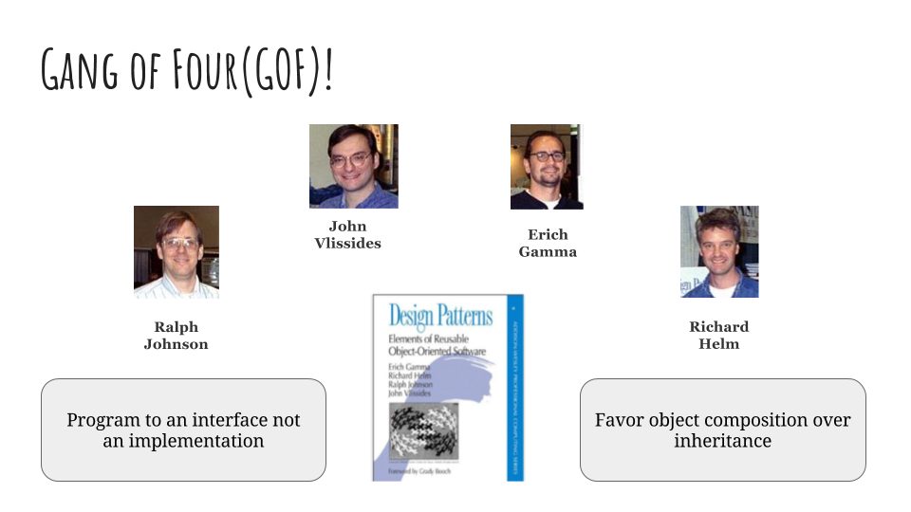
Gang of Four(GOF)
The 4 authors of the famous book “Design Patterns: Elements of Reusable Object-Oriented Software” which is often referred as Gang of Four(GOF) has 23 design patterns which are divided into 3 categories

Slide 7
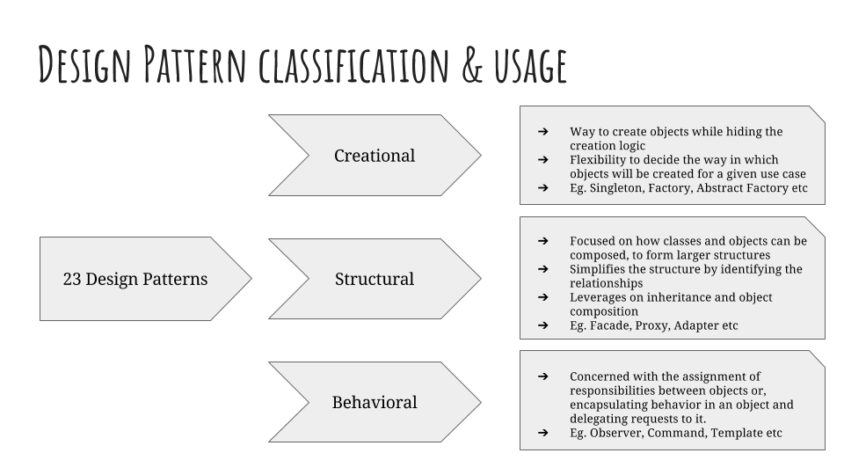
Gang of Four(GOF)

Slide 8
Creational Patterns
This category of design pattern comes in when in an application we are trying to create the objects. This pattern answers on the ways you can instantiate your objects in the application as per your need.
Below is the list of Creational Patterns…… a) Singleton Pattern b) Prototype Pattern c) Factory Pattern d) Abstract Factory Pattern e) Builder Pattern

Slide 9
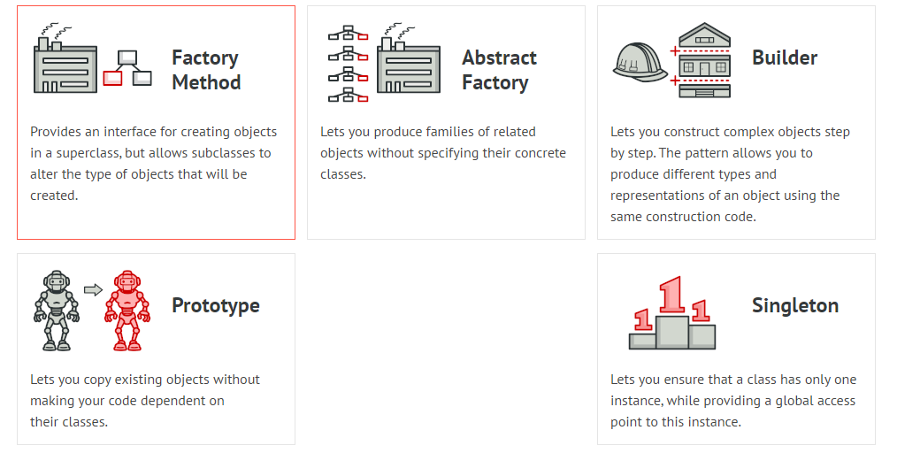
Creational Patterns

Slide 10
Singleton Pattern Usage With Demo
Demo

Slide 11
Factory Pattern Usage With Demo
Demo

Slide 12
Structural Patterns
The word “structure” does it ring a bell? Yes, this category of GOF patterns tells us about how-to better structure our objects and classes to build a larger structures which are flexible and reliable to adapt new changes in the future.
List of Structural Patterns are a) Adapter Pattern b) Bridge Pattern c) Composite Pattern d) Decorator Pattern e) Façade Pattern f) Flyweight Pattern g) Proxy Pattern

Slide 13
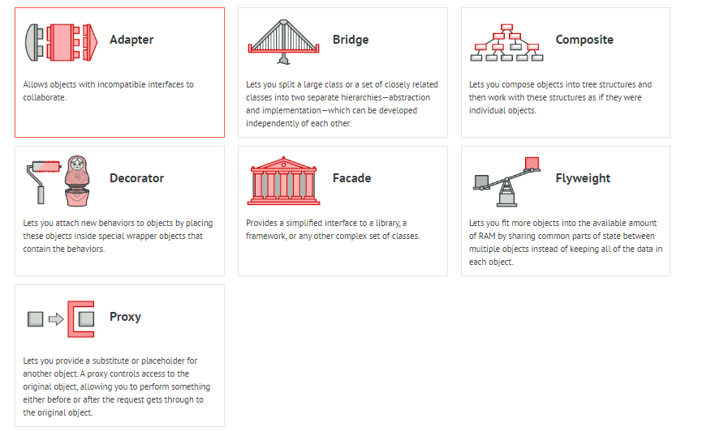
Structural Pattern

Slide 14
Demo on Adapter Pattern
Demo

Slide 15
Demo on Bridge Pattern
Demo

Slide 16
Behavioral Patterns
This category of the GOF patterns talks about how the objects should interact with each other and share the responsibilities accordingly, the objects which are interacting should be loosely coupled where the separation of concerns comes in.
List of Behavioral Patterns are: a) Chain of Responsibility Pattern b) Command Pattern c) Iterator Pattern d) Mediator Pattern e) Memento Pattern f) Observer Pattern
g) State Pattern
h) Strategy Pattern
i) Template Pattern
j) Visitor Pattern

Slide 17
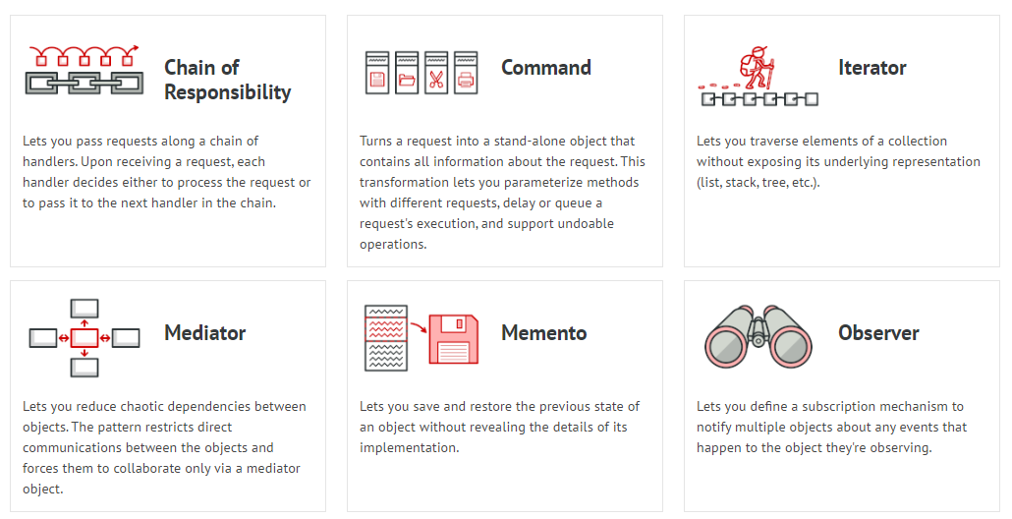
Behavioral Pattern

Slide 18
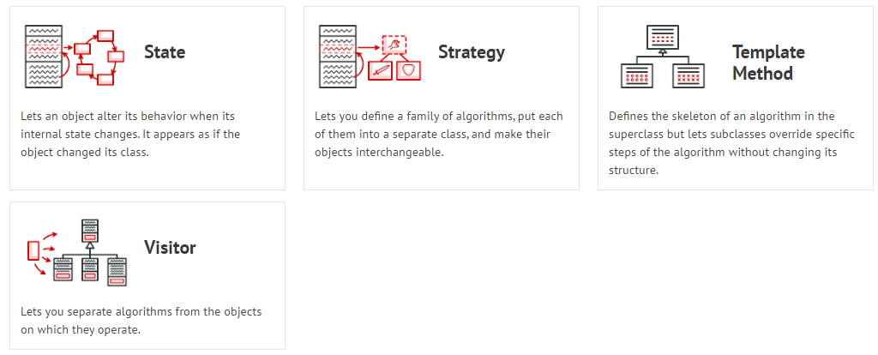
Behavioral Pattern

Slide 19
Demo on Observer Pattern
Demo

Slide 20
Demo on Strategy Pattern
Demo

Slide 21
Clean Coding or Best Industry Practices
Best Practices
Refactoring Exercise in Eclipse
Class Naming Convention
Method and Variable Naming Convention
Comments
Separation Of code
Separation of packages
Formatting Code and Organizing Imports
Documentation
Avoid Repetition of Code
Using tools for best practices like SonarQube etc

Slide 22
Best Industry Practices Demo On Below Pointers
Using Naming Conventions
Ordering Class Members by Scopes
Class Members should be private
Using Underscores in Numeric Literals
Avoid Empty Catch Blocks
Using StringBuilder or StringBuffer instead of String Concatenation
Using Enums or Constant Class instead of Constant Interface
Avoid Redundant Initialization (0-false-null)
Using Interface References to Collections
Avoid using for loops with indexes

Slide 23
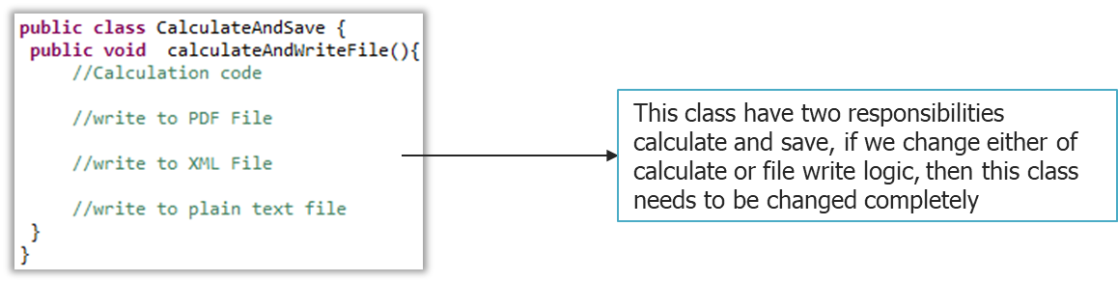
How would you fix this?

Slide 24
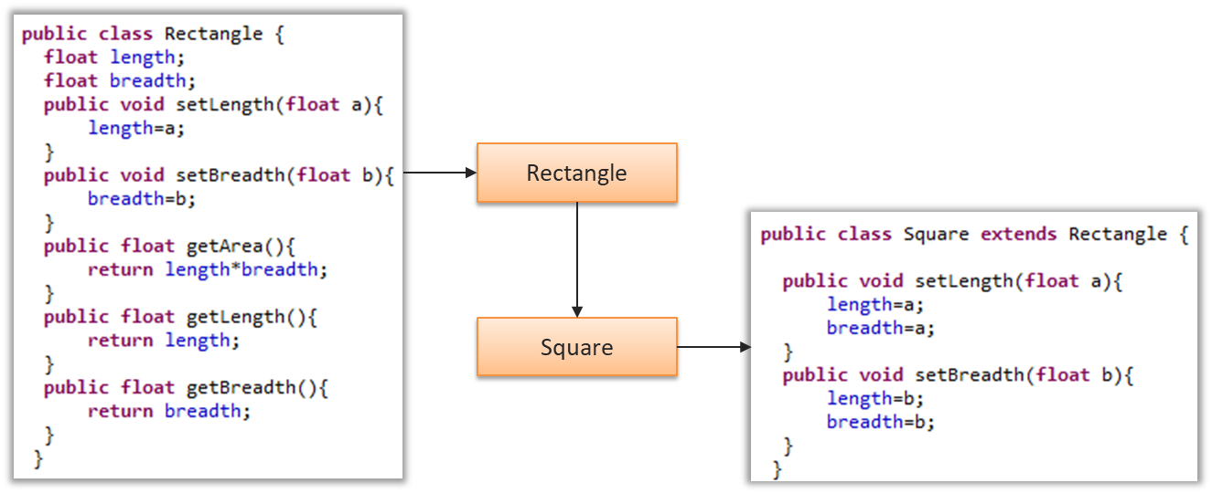
How would you fix this?
Fix coding standards in the above code and also do think of how this separation of classes makes better design?

Slide 25
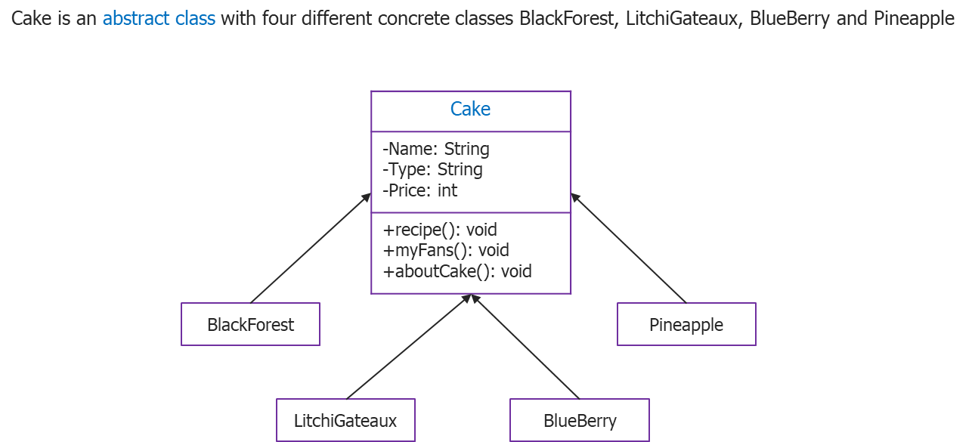
How would you fix this?

Slide 26
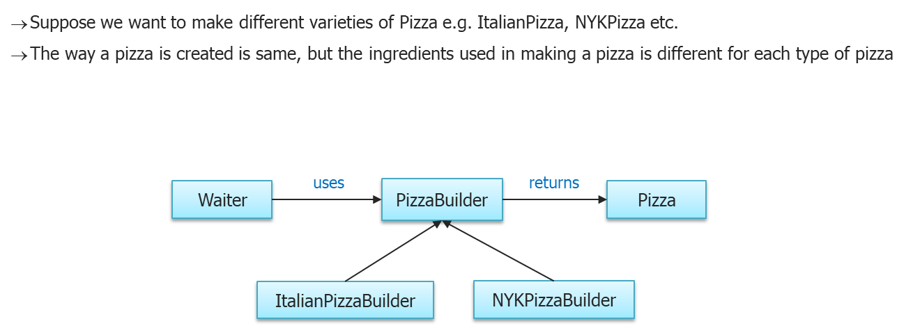
How will you build this?

Slide 27
How will you solution this?
Application development confines working with various third-party APIs
There are lots of cases where the client code can not directly work with third party API because it provides a different interface then what your client code expects
For example suppose there is lot of client code already written using Enumeration, but you need to use a third-party API that uses Iterators rather than Enumeration

Slide 28
Thank You

